Slide 1
Building a blog app
Presented by:
20ap1a0534 : m vaishnavi devi
20AP1A05038 : P BALA YASASVI
20AP1A0508 : B REVATHI

Slide 2
Introduction
Building a blog app allows you to showcase your writing and connect with an online audience.
blog app should have a user-friendly interface and an intuitive navigation system.
Blog facilitates communication and interaction with the user to share knowledge and expertise.
The app should include features such as user registration, blog post creation, and comment sections.

Slide 3
ABSTRACT
Blog is a communication tool that plays a key role in a web application
Use of blogs has resulted in a paradigm shift in the way a web application interacts with the customer
The requirement checklist helps both the web application and the developer during the requirement elicitation of the blog’s software

Slide 4
Developing the Frontend
Design a visually appealing and responsive layout using HTML, CSS, and javascript.
Implement features like user registration, login, blog post creation, editing, and deletion.
HTML
html stands for hypertext markup language. html displays the content on the page like buttons, links, headings, paragraphs, and lists
CSS
css stands for cascading style sheets. css is responsible for the style of your web page including colors, layouts, and animations.

Slide 5
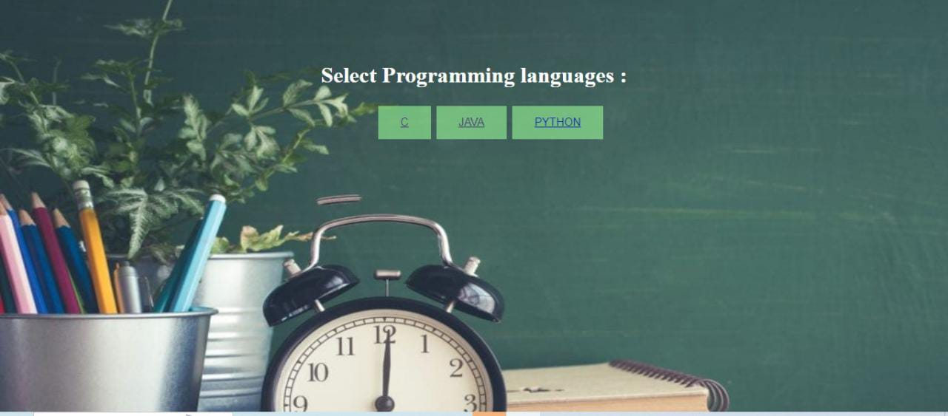

Slide 6
Testing and Deployment
Perform rigorous testing to ensure that the blog app functions smoothly and without any bugs.
Test the pp on different devices and browsers to ensure cross-compatibility
Remember, this is just a brief overview of the steps involved in building a blog app. Each step requires detailed planning and implementation, but following this framework will set you on the right path to creating a successful blog app.

Slide 7
Advantages
Blog brings traffic to your website.
Helps you generate more leads and conversions
Helps you repurpose content for other marketing channels
Helps you build authority in your industry
Helps you strengthen brand recognition.

Slide 8
Disadvantages
It takes a huge upfront investment of time and work.
It's a lot more difficult than it looks.
Passion isn't enough.
Blogging for your business can actually hurt you if you do it wrong.
Blogging while traveling full-time isn’t a small tasks.

Slide 9
conclusion
If the blog states the benefits of a product/service to the reader, you can invite her to look at the website’s services/product page.
As a result, they will be more likely to come back for other informative blogs put up on your site.

Slide 10
Thank you

